Slide 1


Work-Based Learning Partnership
GolfWorks & Adecco
Sheri White
GolfWorks
Human Resources
swhite@golfworks.com
740.328.4212
Barrett Bridgewater
Adecco
Program Manager – Work Based Learning
Barrett.Bridgewater@adeccona.com
859.771.9995
Notes:
Barrett speak first.
Introduce Sheri White

Slide 2

GolfWorks is the golf industry’s most complete source for golf club components, clubmaking tools and supplies and technical information.
Notes:
Sheri continue to speak about GolfWorks and what you do.

Slide 3

The Nation’s Leading Provider of Workforce Solutions
Adecco At-a-Glance
450+
Locations across the U.S.
70,000+
Associates on assignment weekly
1,600+
Colleagues
2 Years in a Row
Certified Great Place to Work
7,000+
Clients served weekly
$5.1 Billion
In revenue in 2018
(North America, all brands)
Niche Solutions
By industry, skill set, geography, etc.
Please note: We can only report revenue as it is stated in our annual report
Notes:
Barrett quickly explain Adecco.
About Adecco
We are one of the nation’s leading providers of recruitment and workforce solutions.
With more than 450 locations and coverage in virtually every state, we connect more than 70,000 talented workers to the best job opportunities each week. Our experience is at every level of operation as we offer staffing for more than 400 skill sets across multiple skill categories:

Slide 4






Adecco’s Work-Based Learning
Mission
Close America’s Skills Gap
Develop sustainable talent pipelines
Creative Workforce Solutions
Goals
Upskill 5M People
Reach 10,000 Apprenticeships
Skills Gap
Businesses
Work-Based Learning Models
Registered Apprenticeship
Upskilling/Reskilling
Cooperatives
Internships
Direct Talent Sources
High Schools & Colleges
Community-Based Organizations
Military, Veterans, Justice, Adult Ed
Education Providers
Secondary Schools
Community Colleges
General Assembly
Penn Foster
Workforce
Ecosystem
Government
“U.S. DOL/U.S ED/State, and Local Government”
Notes:
Barrett
This represents Barrett’s work at Adecco.
-Mission
-It all started with the YES! Program
-Goals
As we work toward the development of a Workforce Ecosystem

Slide 5
What is the Skills Gap?
Employment Landscape
The perceived mismatch between the needs of employers for skilled talent
and the skills possessed by the available workforce.
Employment Landscape
Causes
3.3%
Unemployment rate
Talent Shortages
6M
Unemployed Americans
Lack of Preparation
Insufficient Wages
7.1M+
Jobs going unfilled
Inadequate On-the-Job Training
63%
Working-age individuals are employed or seeking a job
New Technology
10K
Baby Boomers retire daily
Unrealistic Expectations
Source: American Staffing Association
Notes:
Barrett
TALKING POINTS:
Why are we doing this? Because of the Skills Gap.
Employment Landscape
Unemployment rate: 3.3%. This makes competition for available talent fierce.
There are 6.9M+ jobs going unfilled. But there are 7.1M people looking for work.
Workforce participation rate: 60%. That means 40% are still sitting it out.
10,000 baby boomers retiring each day. There are not enough people in Gen Y & Z combined to replace the number of retirements. So we need every person to reach their potential to reach equilibrium.
However, U.S. youth unemployment is more than double the national unemployment rate. Research tells us that youth who do not obtain jobs early in life are much more susceptible to limit their career growth.
Causes
Shortage of skilled talent. There are just not enough people.
Lack of Preparation. The “College for All” mentality is failing us.
40% of college Freshmen dropout. So what happens to them?
Nearly ½ of people with college degrees are Unemployed or severely Underemployed 2-3 years after graduation
This causes defaults on student loans. We have a $1.4 Trillion student loan debt problem. This is more than credit card debt in the U.S.
College Degrees only “signal” that someone is worth giving a chance… but they will still require a lot of training.
Students are not being properly prepared for the real world of work
Insufficient wages to attract specialized talent
Lack of on-the-job training
New technology disruptions requiring specific new skills
Unrealistic expectations of job applicant training and experience
Additionally, we recognize some other key drivers of the skills gap:
Education
Lack of career exploration and exposure to in-demand professions/industries
Partly due to a push toward academics and college for many years
We are dealing with the aftermath of the effort to suppress vocational training programs in our recent history. Career Technical Education is finally reenergizing in response to that. Still only 2% of high school students are in CTE classes in the U.S.
Perception of College vs. Apprenticeship
Perception of skilled trades
Work Readiness
Businesses cannot find people with the right skills
For those 6.9M jobs going unfilled:
Employers identify lack of experience as the main barrier to entry-level vacancies.
2nd is a lack of soft skills / essential skills.
3rd is lack of education. So education is still important. But it is 3rd on the list.
Mostly, employers are looking for skills, professional certifications, and the essential skill foundations upon which they can train people.
Also, due to societal breakdowns there is a decline of the most common pathways to skilled jobs
Family Support
Mentorship
Employers can no longer rely on these traditional pathways. So more and more employers are considering Apprenticeship.
Solutions to the Skills Gap and other workforce challenges will require more than just staffing solutions. They will require workforce solutions.

Slide 6


Evolve Your Hiring Model
YES! Model
Traditional
Sourcing Methods
Youth Employment Solutions Program
Available Workforce
Businesses
High Schools
Businesses
Notes:
Barrett
TALKING POINTS:
Our work is truly to develop workforce solutions to help businesses.
On the left is what most businesses are doing. This is a traditional or transactional recruitment model.
The right side represents the YES! Program that helps businesses develop partnerships with educators.

Slide 7
GolfWorks Student Program - Framework
Access a Talent Pipeline
WBL Training Agreement
  A Teacher drafted document
  Goals for the student
  Teacher, Student, Parent, and Employer will sign it.
  Weekly Review Sheets
Lakewood High School
Sheridan High School
Preparation
&
Eligibility
Accountability & Flexibility
  Athletics Programs, Music
  School eligibility requirements
  Referrals from Teachers + current students!
  Accountability while still in school
  Adecco support
  Flexibility on work schedules etc.
Notes:
Sheri
At first we had many questions and multiple challenges. I will talk about our challenges later. But, this was something we had always wanted to do. Then, once we learned Adecco could provide assistance as the Employer-of-Record which covers Workers Compensation Insurance, we were able to jump in.
And now after 2 ½ years this represents our program.

Slide 8

  Mentorship
  Job Training
  Skill Development
  Personal Development
  Flexibility
Value is found here!
GolfWorks
Program Appeal
  Real Work to Perform
  Real Work Experience
Essential
Pyramid of components we offer in our Work-Based Learning program?
  Wages
  Great
  Culture
  Great
  People
  Incentives:
  Employee Benefits
  Performance Pay
  Health & Wellness Programs
Basics
Notes:
Sheri

Slide 9



Mentoring the “Why Generation”
Millennials and Gen Z together are often called the “Why Generation” because they want to know the reason “why” behind everything. We recommend the book “Answering Why” by Mark C. Perna to learn more about how to unleash performance in this generation.
SENSE PURPOSE
Knowing why lends credibility to their willing participation. Once they are locked in on a mission then the work they do transcends “work” and become a worthwhile pursuit.
EXPERIENCE IS KING
Their desire for unique and positive experiences can be the greatest motivational tool you have. Involving them in meetings or experiences, giving them a voice, and allowing them to share via social media will unlock their desire to perform more than monetary incentive.
IMPACT
Show them how their work has impact. Help them connect the dots between their activity and the team, customers, company, and community. This helps to engage their sense of purpose. Leaving with more skills and experiences (communication).
Source: “Answering Why” – Mark C. Perna
Notes:
Sheri – businesses may be nervous about mentoring and training this generation… but here is what we have learned.

Slide 10
Challenges
ROI
Hours
Internal Commitment
Stay or Go @Graduation
Notes:
Sheri
Source: Adecco White Paper: The Importance of Employee Training
Increased Productivity - According to a study conducted by IBM, a company gains $30 worth of productivity for every $1 spent on online learning.
Increased retention - The Research Institute of America also found that eLearning can increase retention rates by 60%
Reduce Hiring Costs – Investing in employees is s wise business choice that not only yields a significant return on investment, but also saves your company form having to hire more experienced employees or adding additional employees who can cover certain skill sets.
Builds a Committed Team – Looking at the resources on your existing team should always be the first step when addressing needed skill sets. Consider who may be able to develop a needed skill in a short amount of time rather than looking externally for another resource. Investing internally is a powerful way to build a strong, committed team and to uncover the skills you need.

Slide 11
Challenges become Benefits
ROI:
Positive
Hours: Maintained staffing levels
Internal Commitment:
Deeper support to our CSR mission
Team building
Stay or Go @Graduation
-Create awareness
-Develop the workforce
-Consistent Pipeline
Community Engagement
& Branding
Notes:
Sheri
Source: Adecco White Paper: The Importance of Employee Training
Increased Productivity - According to a study conducted by IBM, a company gains $30 worth of productivity for every $1 spent on online learning.
Increased retention - The Research Institute of America also found that eLearning can increase retention rates by 60%
Reduce Hiring Costs – Investing in employees is s wise business choice that not only yields a significant return on investment, but also saves your company form having to hire more experienced employees or adding additional employees who can cover certain skill sets.
Builds a Committed Team – Looking at the resources on your existing team should always be the first step when addressing needed skill sets. Consider who may be able to develop a needed skill in a short amount of time rather than looking externally for another resource. Investing internally is a powerful way to build a strong, committed team and to uncover the skills you need.

Slide 12

Engagement with Schools
Outreach
Job Fairs
Meeting Parents
Business Advisory Councils
Supporting our Students
Visiting
Communicating with Teachers
Go to their extra-curricular events (Athletic Events, etc)
Adecco
Facilitating initial discussions
Ensuring alignment
Providing best practices and ideas
Notes:
Sheri

Slide 13

Adecco’s Role
Notes:
Back to Barrett

Slide 14

Adecco YES! Powers Work-Based Learning Programs
Employer-of-Record
Workers Compensation Insurance
Adecco is the Employer-of-Record EOR
We employ and pay the students
We keep track of hours and other information requested by the Department of Labor
We take on workers’ compensation
Child Labor Laws
Hazardous Occupations
  Exemptions for “Student learner or apprentice”
YES! helps businesses define the scope of work and create the program.
  Within Department of Labor child labor regulations, OSHA, wage and hour laws, etc.
  Job Description
  Safety Walk-Through
  Best practices for Model evaluation and implementation
  Facilitate conversations with local schools
Businesses have two barriers to offering youth employment
Notes:
Barrett
Businesses have 2 barriers to hiring youth: Child Labor Laws and Workers Comp Insurance.
Child Labor Laws prohibit people underage from working in 17 different “hazardous occupations.” However the Federal Law states exemptions for “bonafide student learners or apprentices.” So we provide the expertise to help a business walk through the laws, define what students can and cannot do, and put together a legal program of job duties and a job description.
Workers Comp – Your Workers Compensation Insurance carrier will not allow you to hire underage. Or it may just be too expensive. Adecco becomes the employer of record so we take on workers comp insurance, paying the students, payroll taxes, etc.
Then, once they are 18 and graduated you will have an opportunity to make them a full-time job offer.

Slide 15

Overview
Bridging the Gap and Removing Barriers
  Adecco YES! carries Workers Compensation Insurance
  Engaging Businesses & Schools
Accountability & Flexibility
Work-Based Learning Program
Challenges Become Benefits
  Know where VALUE is found in your WBL Model
  Profitable response to the Skills Gap
High Schools
Businesses
Notes:
Barrett
This is my last slide and just provides an overview.

Slide 16
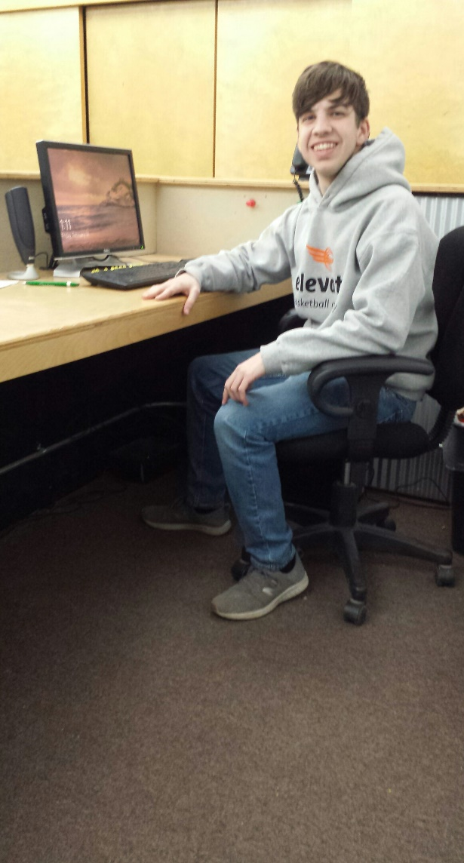
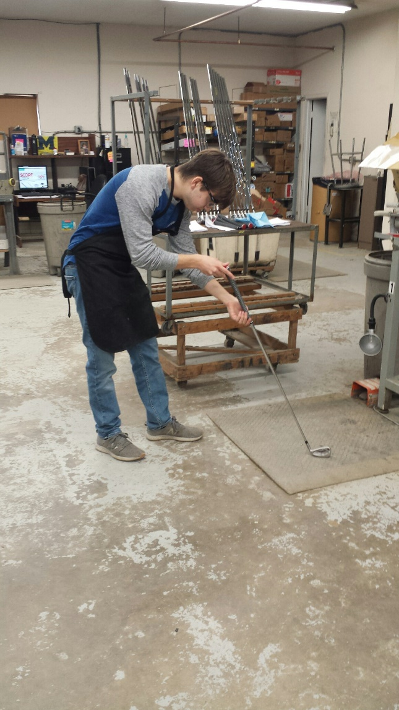

THANK YOU!
Students at work:
Contact Center
Golfball Imprinting
Production
Notes:
Sheri

